Slide 1
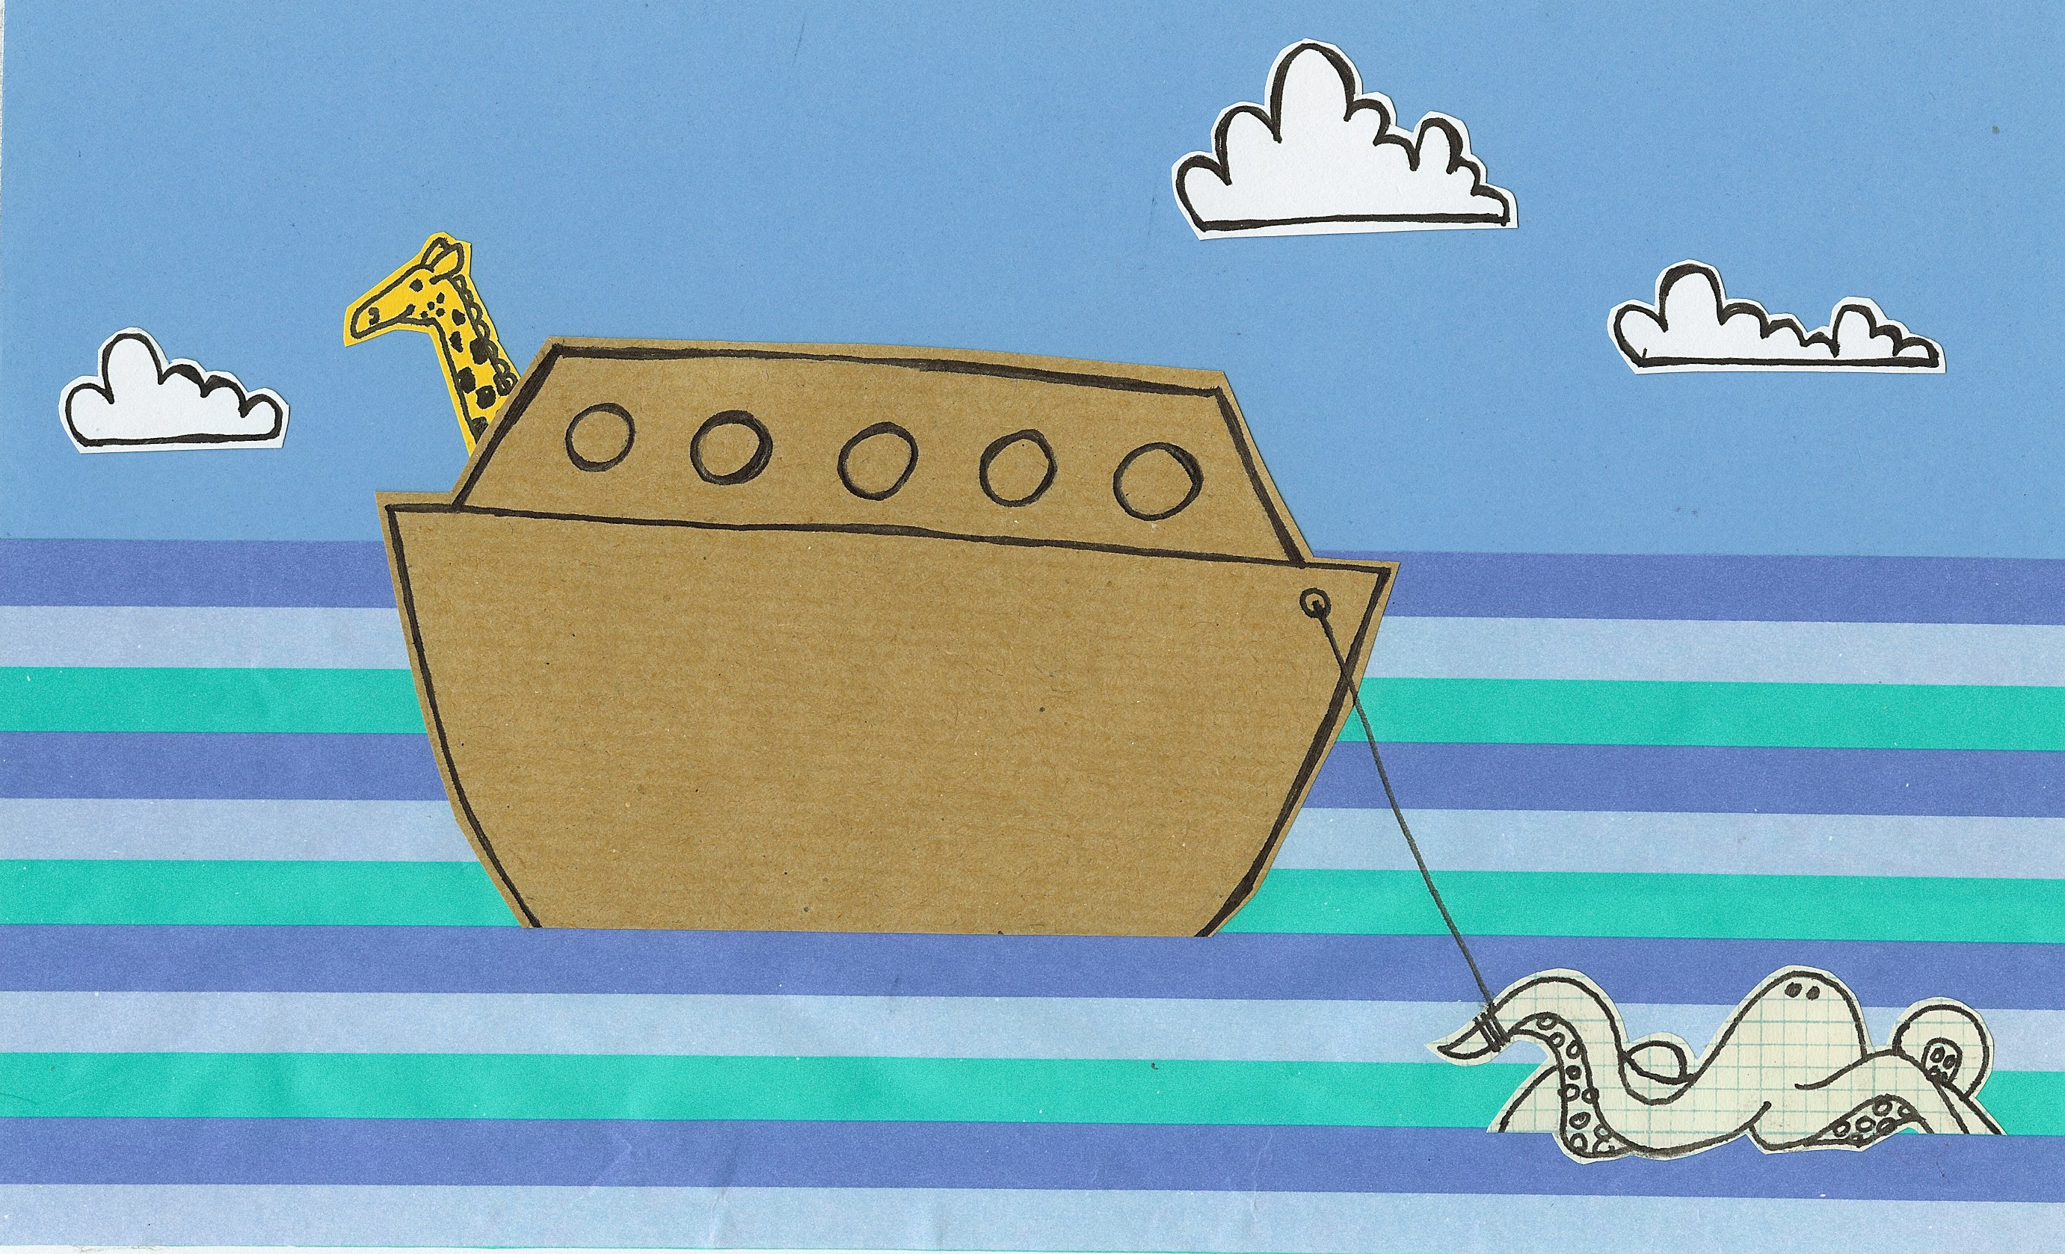
We don’t have to build an ark
a great big floating safari park

Slide 2
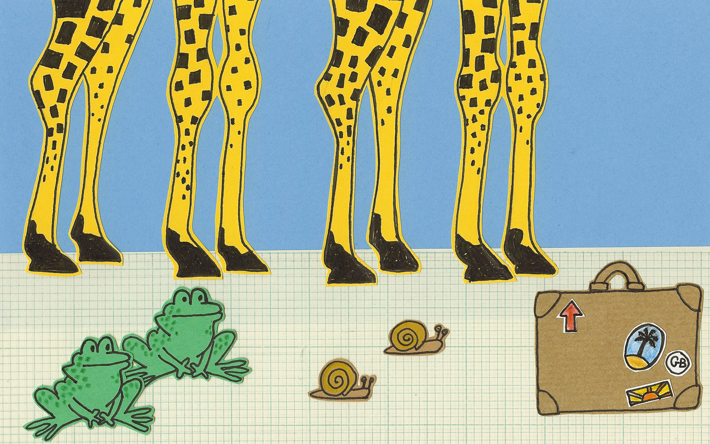
or collect animals all in twos
and take them on an ocean cruise

Slide 3
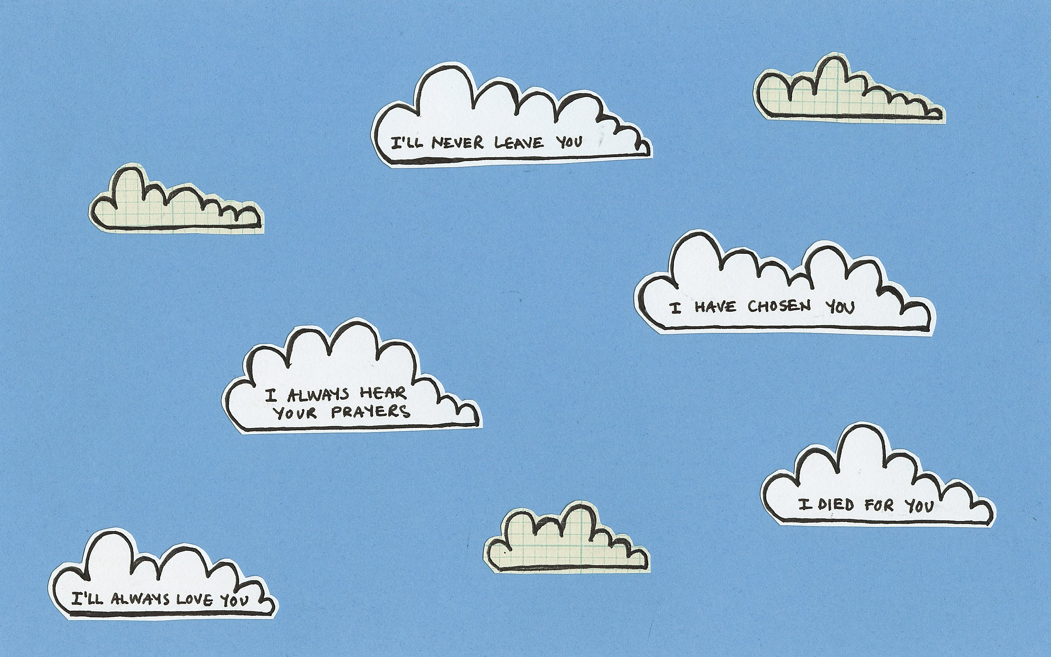
Remember God loves You.
Remember His promises.

Slide 4
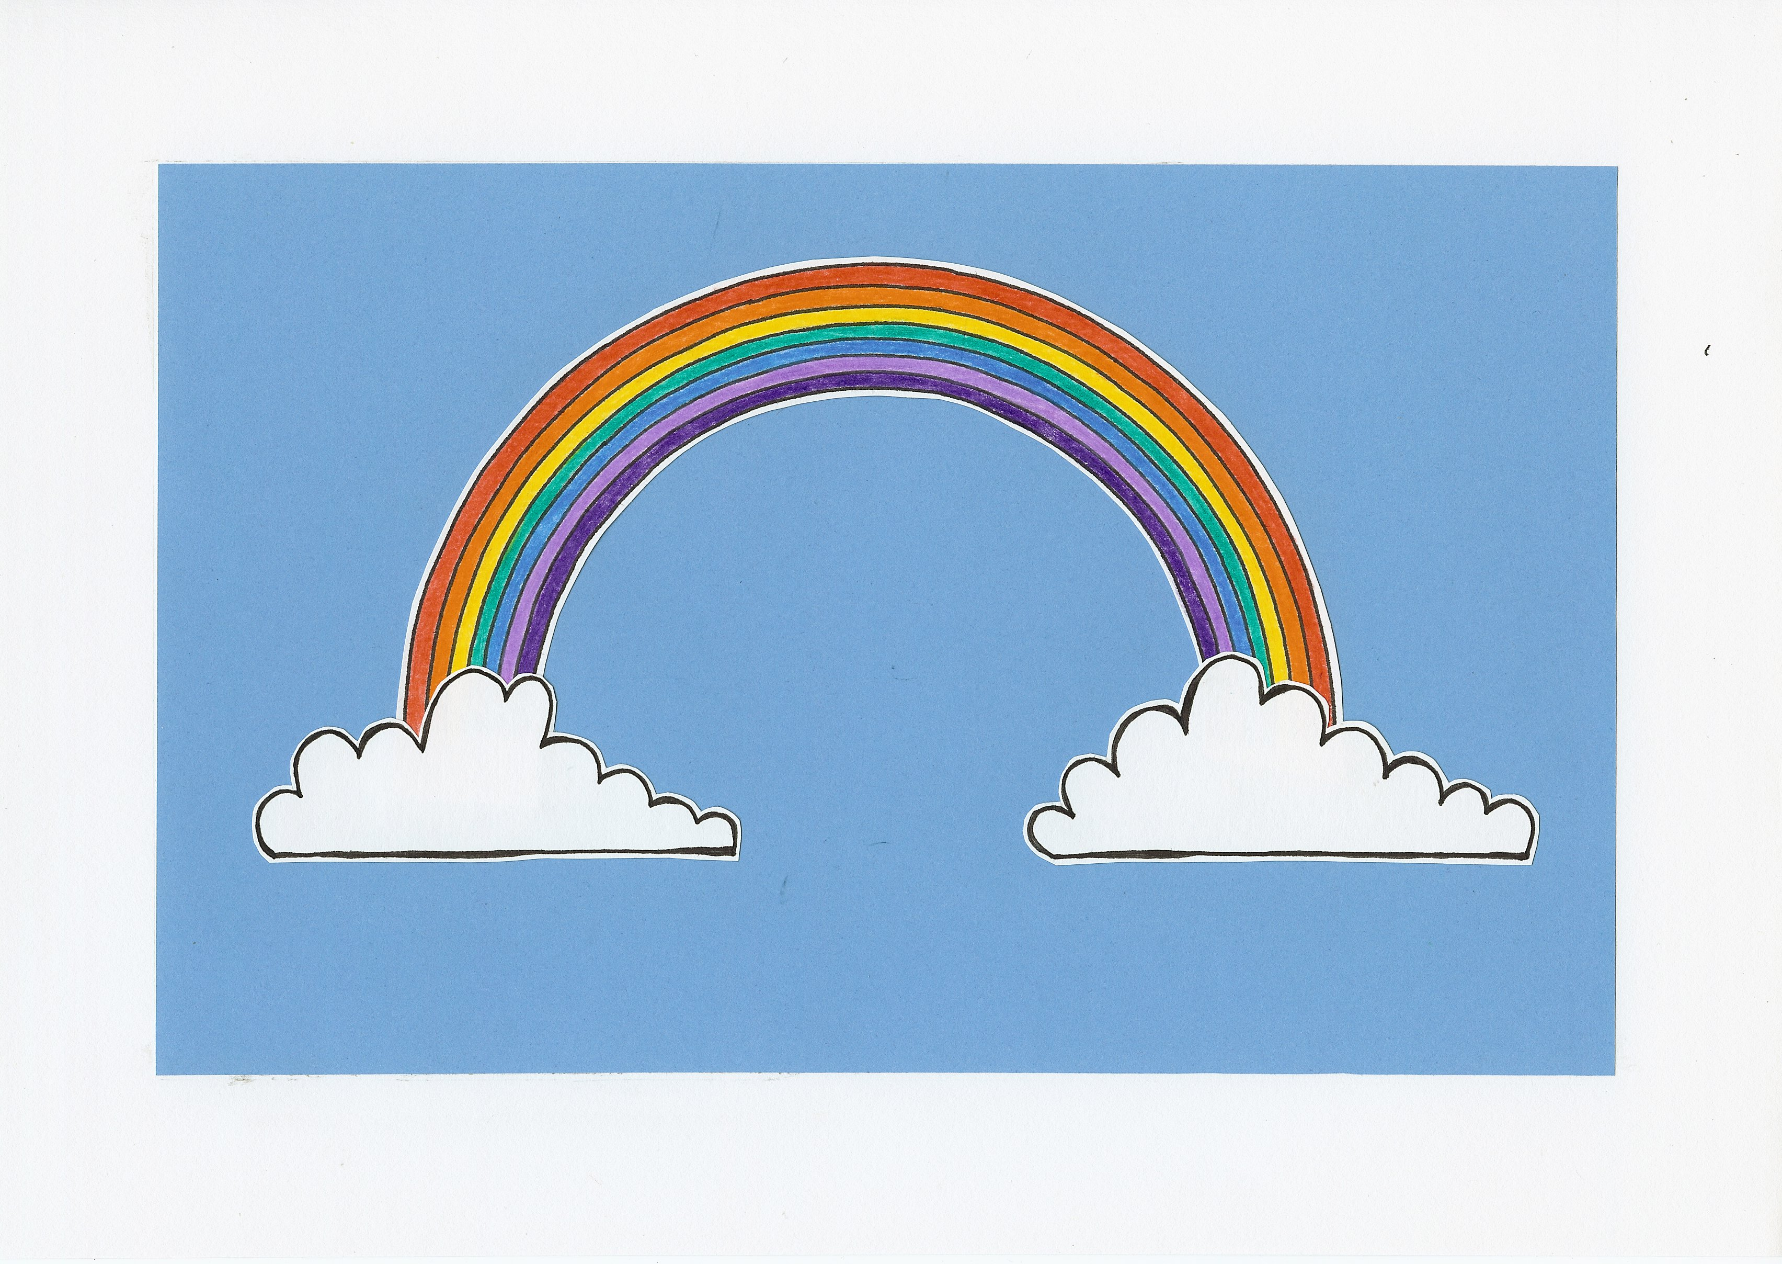
Remember the rainbow -
God always means what He says.

Slide 5
Remember God loves You.
Remember His promises.

Slide 6
The rainbow shows God means what He says.
Be do do do do do be do do!

Slide 7
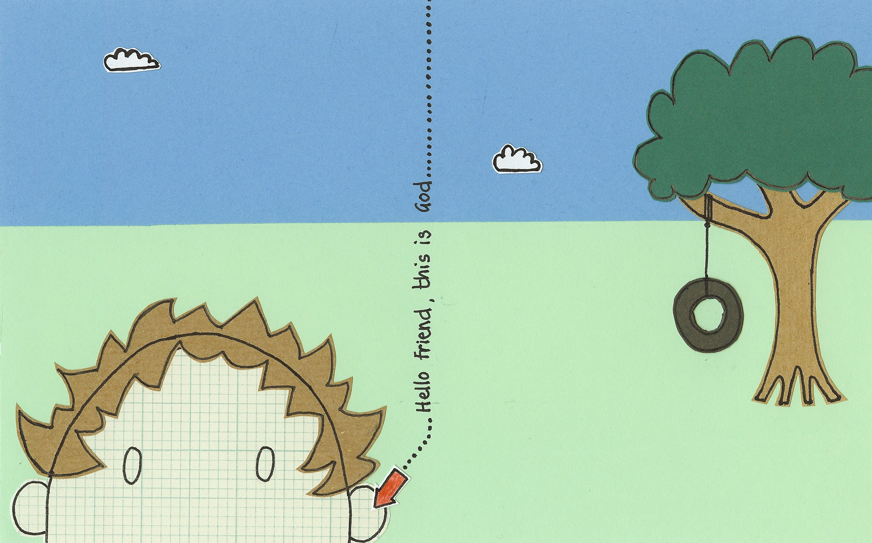
Help us Lord hear what You say -
to please You in our work and play;

Slide 8
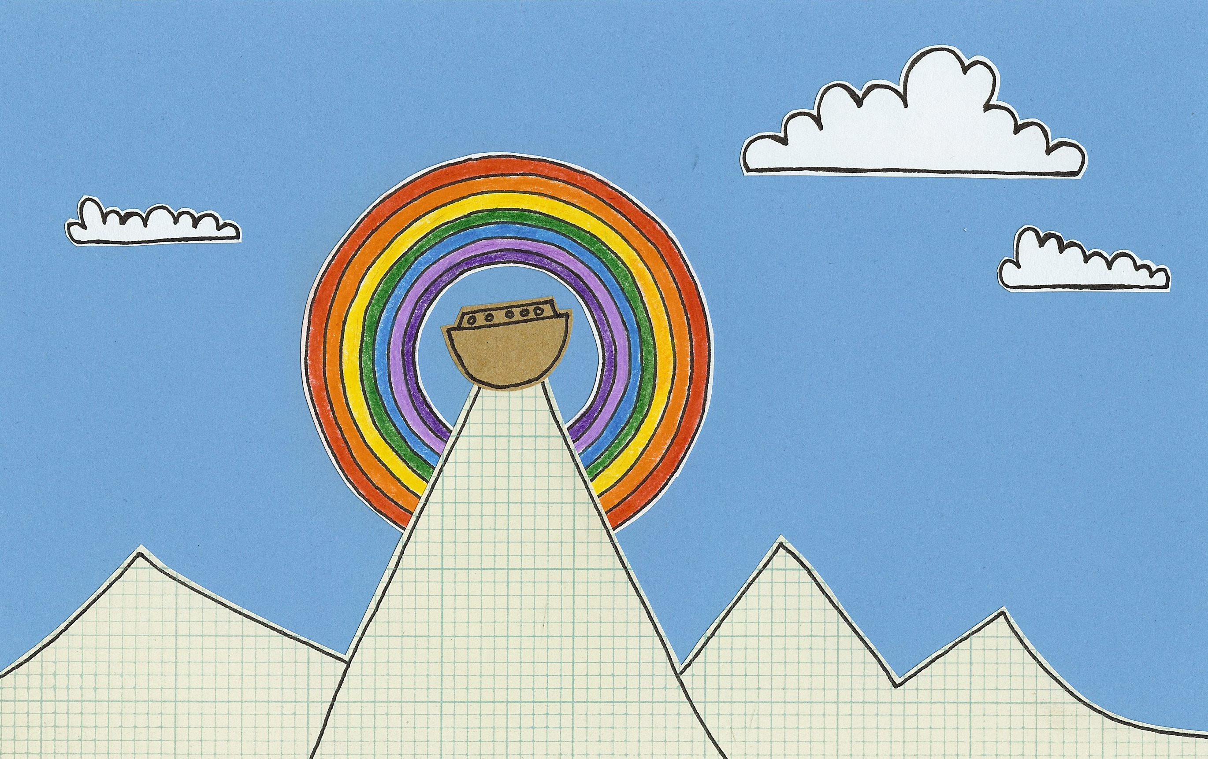
be Your friend throughout the day
and, just like Noah, learn to obey.

Slide 9
Remember God loves You.
Remember His promises.

Slide 10
Remember the rainbow -
God always means what He says.

Slide 11
Remember God loves You.
Remember His promises.

Slide 12
The rainbow shows God means what He says.
Be do do do do do be do do!

Slide 13
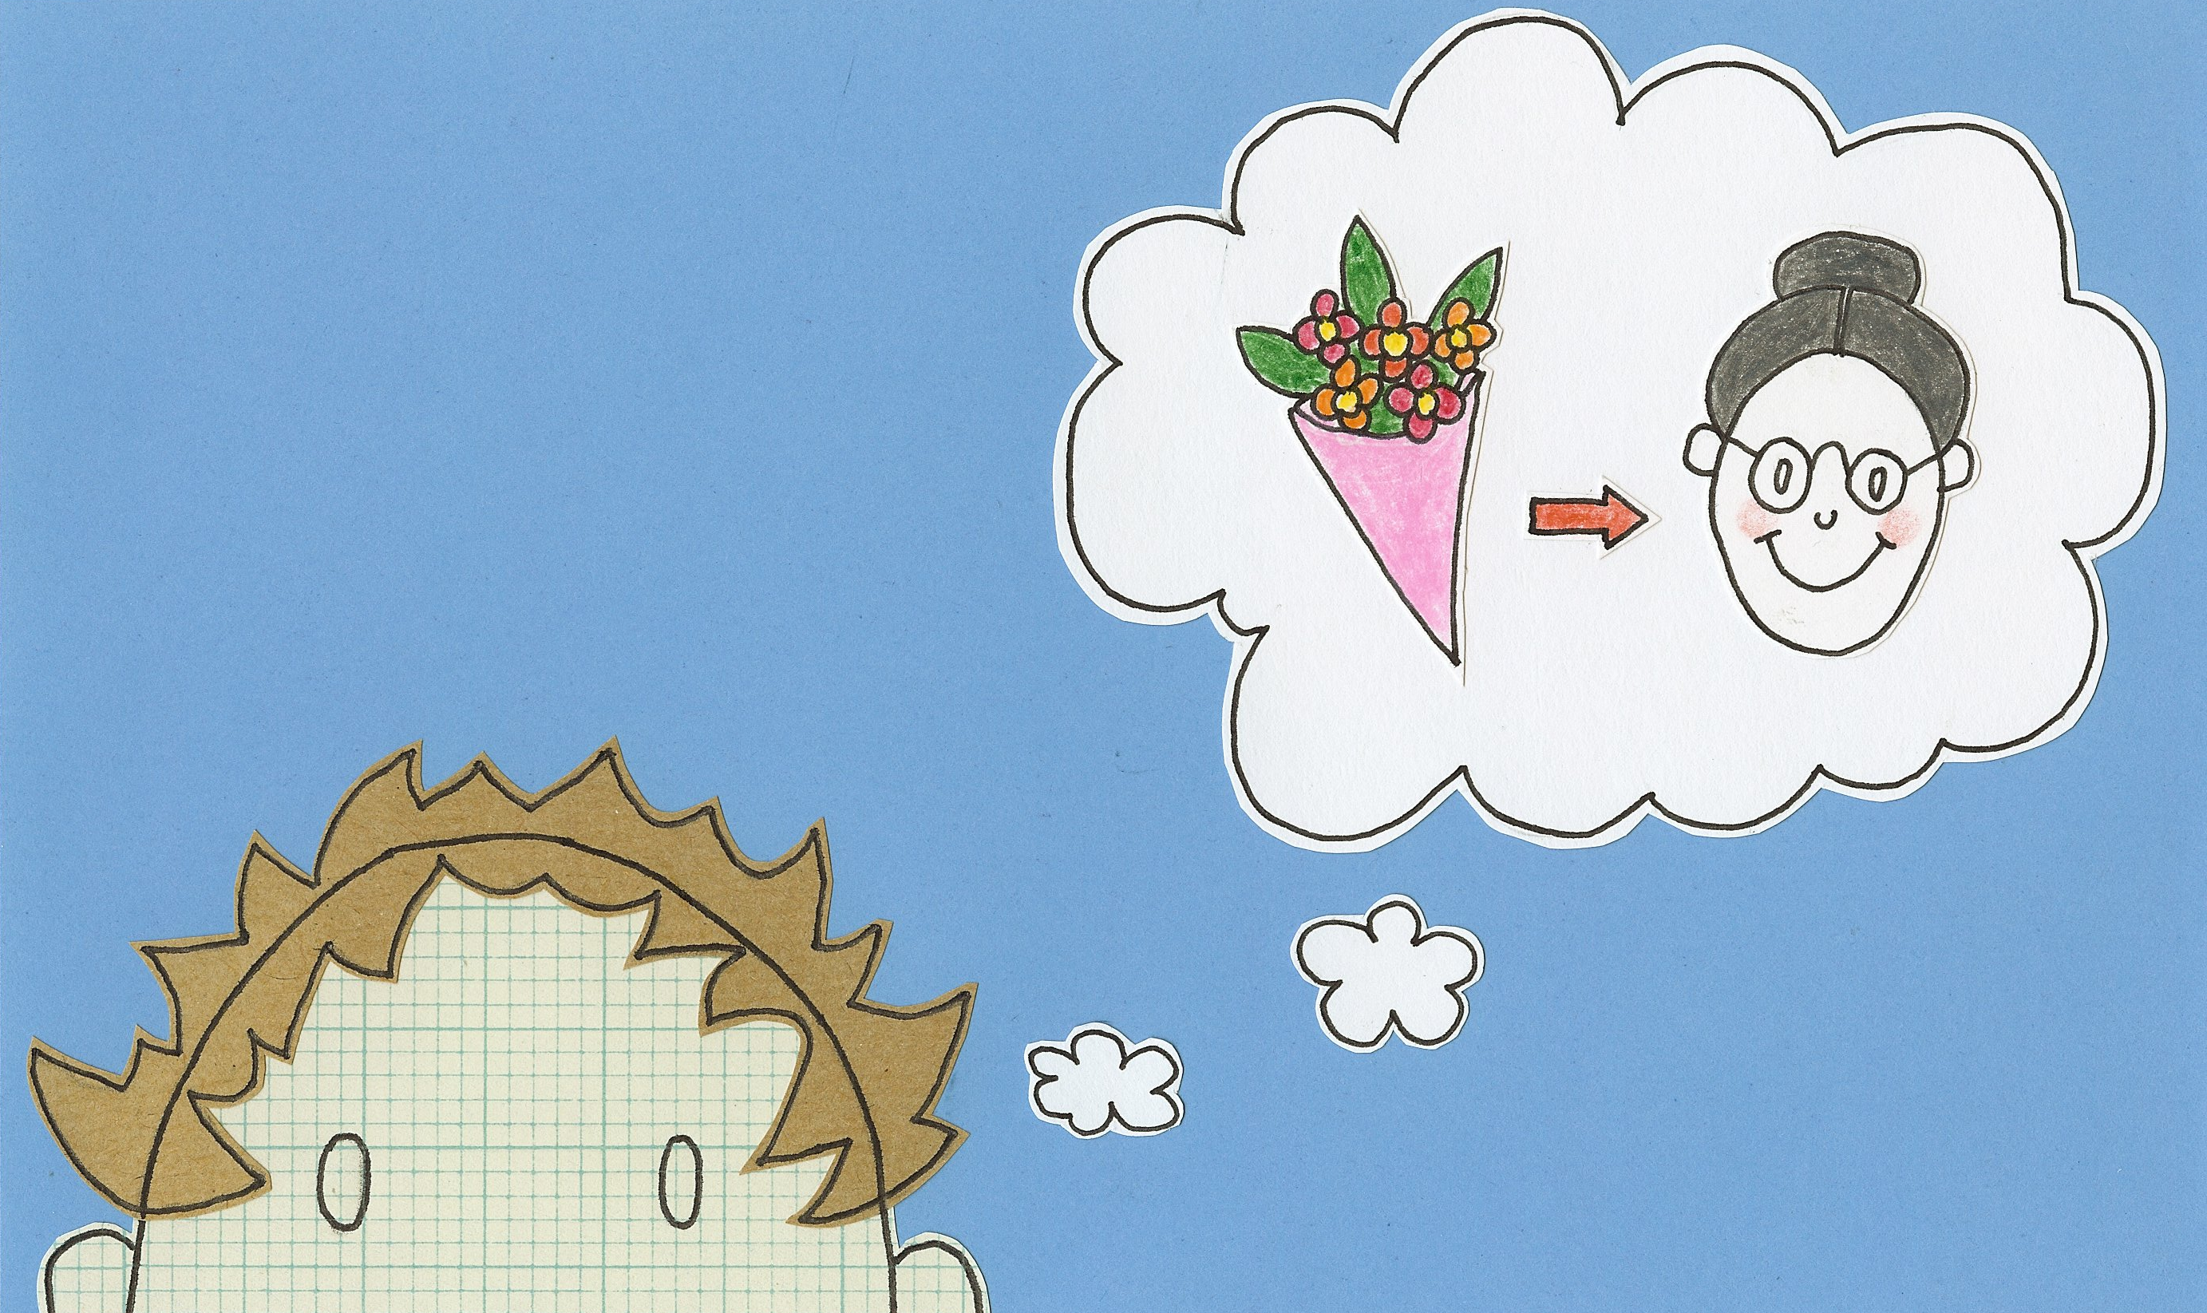
Show us Lord what we should do.
Remind us we can count on You.

Slide 14
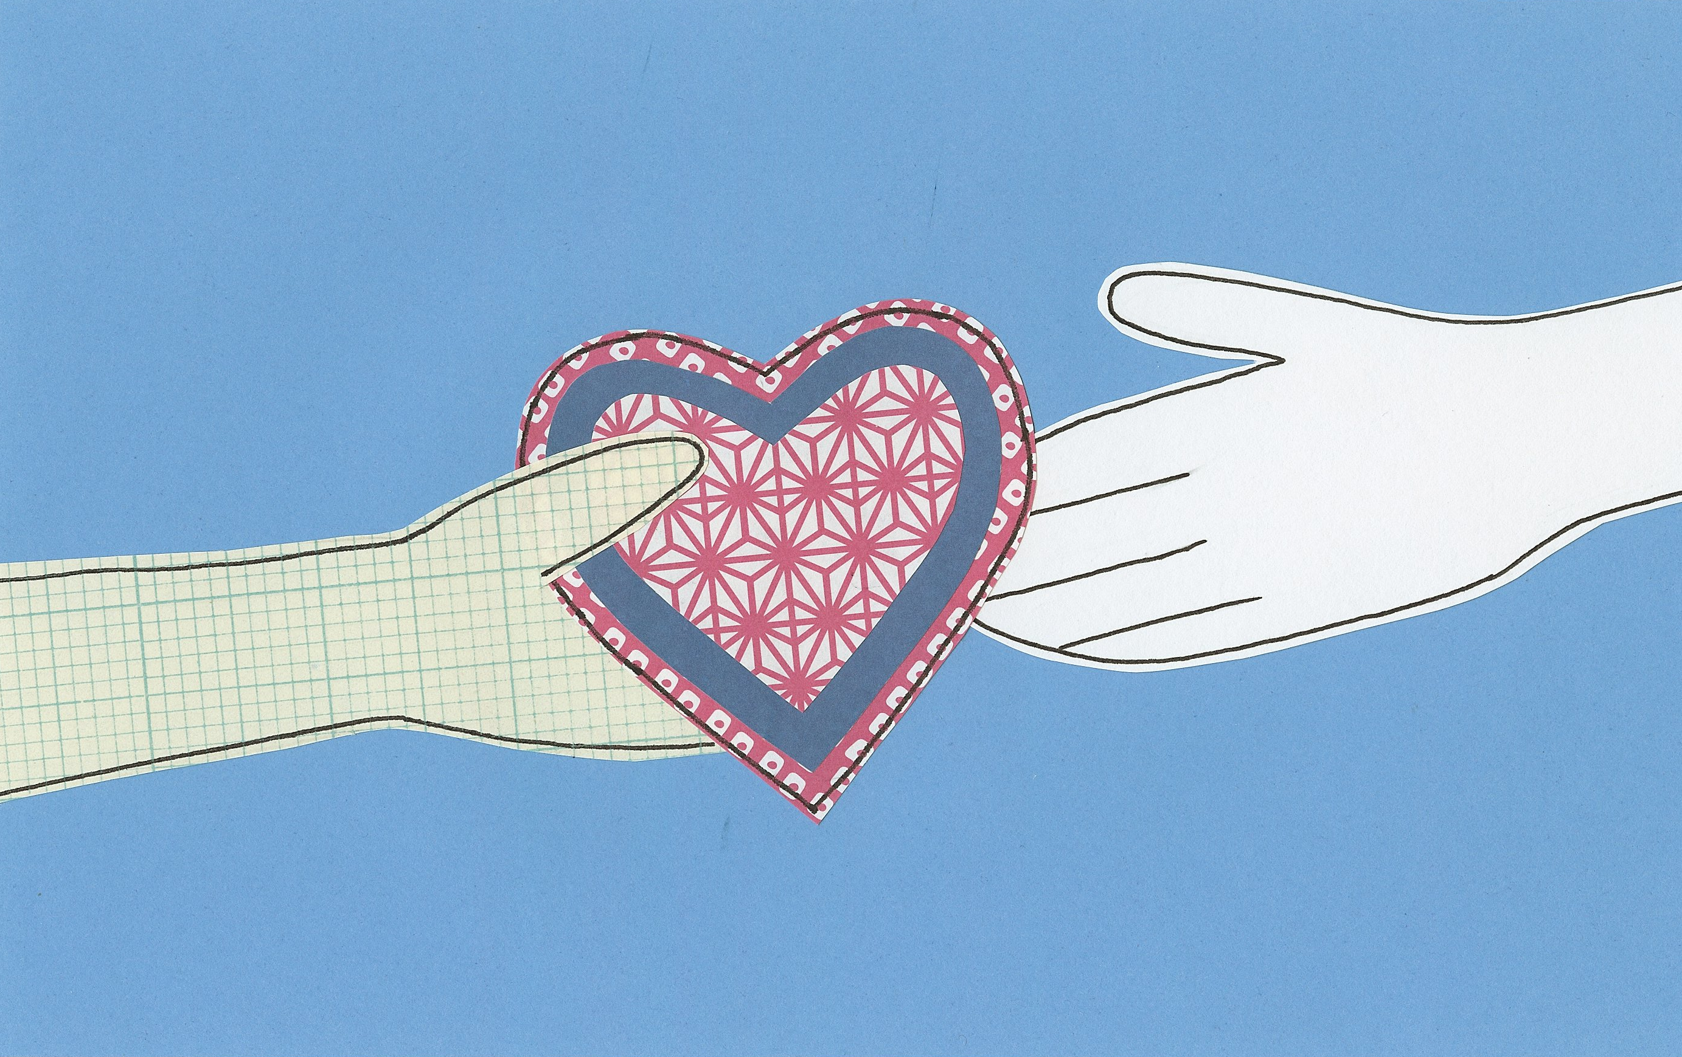
Pour Your love into our lives -
we’ll pass it on so that peace arrives.

Slide 15
Remember God loves You.
Remember His promises.

Slide 16
Remember the rainbow -
God always means what He says.

Slide 17
Remember God loves You.
Remember His promises.

Slide 18
The rainbow shows God means what He says.
Be do do do do do be do do!
© 1995 Greg Leavers Pictures © 2009 Lucy Sheridan

