Slide 1
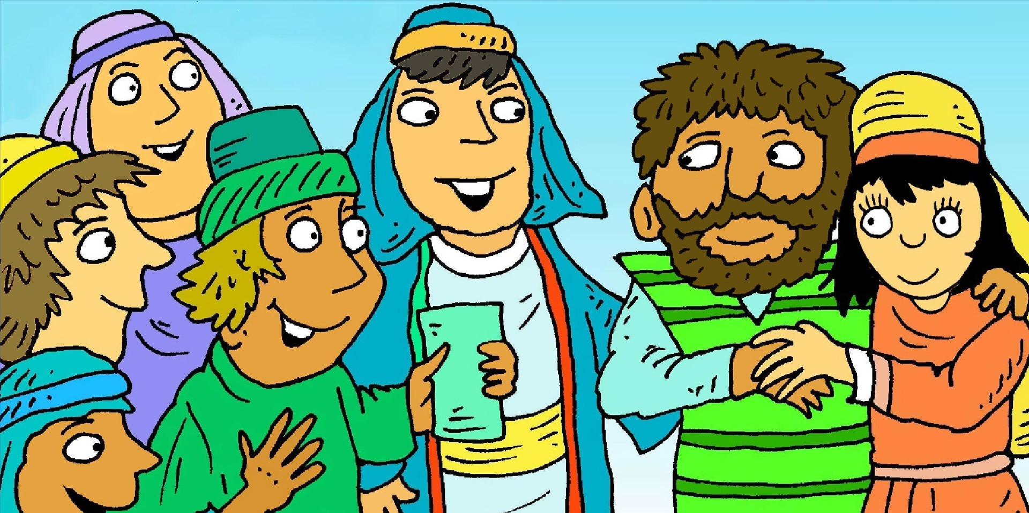
Jesus and His friends went to a wedding nearby, Halfway through the feast, the wine supply ran dry, Mary said to Jesus, 'Can you help them here?’
Then said to the servants these words,
loud and clear:

Slide 2


"Simply do what Jesus says,
It opens the way for Him to bless,
Simply do what Jesus says;
It works out for the best.“

Slide 3
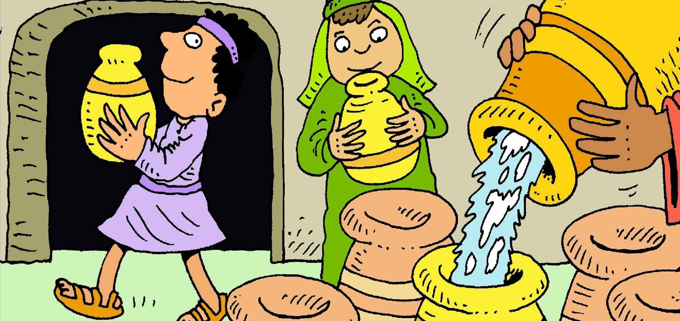
Jesus said, "Fill those stone jars with water, right up",
The servants did, then from the jar they filled a cup,
The M.C. tasted from the cup - "It's the best - it's fine!"
Jesus knew, the servants knew –
WATER TURNED TO WINE!

Slide 4
"Simply do what Jesus says,
It opens the way for Him to bless,
Simply do what Jesus says;
It works out for the best.“

Slide 5

When we are confused and don't know what to do,
Whatever's going on, in good or bad times, too,
When you need encouragement; some sort of hope,
Remember and think through
the words that Mary spoke:

Slide 6
"Simply do what Jesus says,
It opens the way for Him to bless,
Simply do what Jesus says;
It works out for the best.“
© 2020 Greg Leavers
Pictures: Richard Gunther (used with permission)

