Slide 1
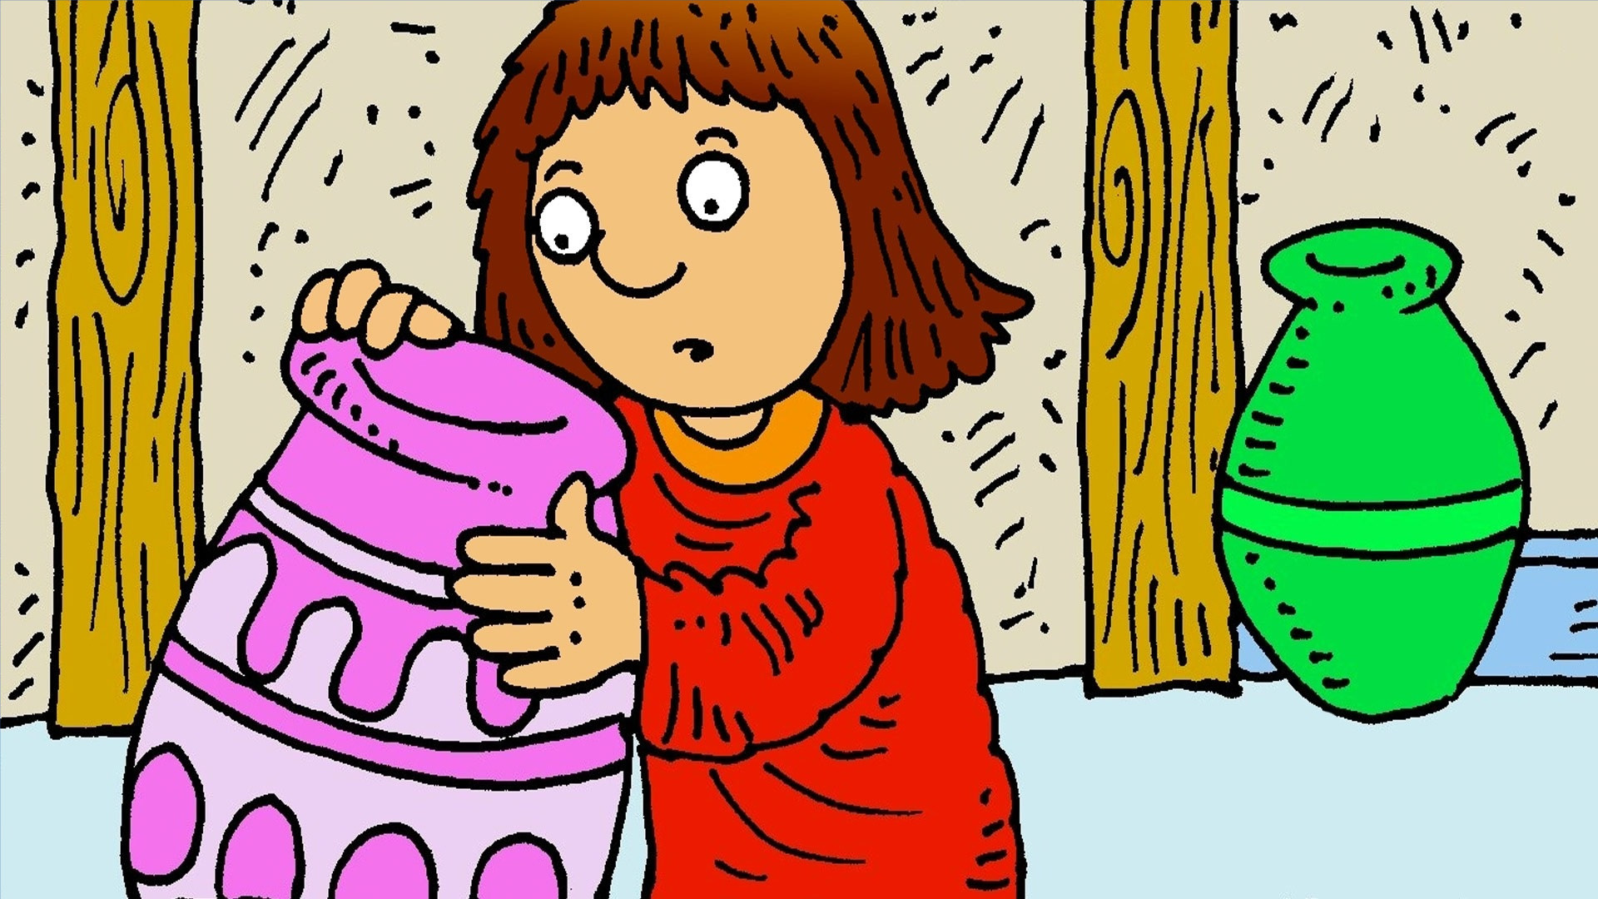
Looking on the ground, searching all around,
my lost coin must be found,
I used to have ten, all silver and then,
one went missing some-when.
I've looked in the front room, I looked in the back room,
I've looked in every cupboard, swept every floor.

Slide 2
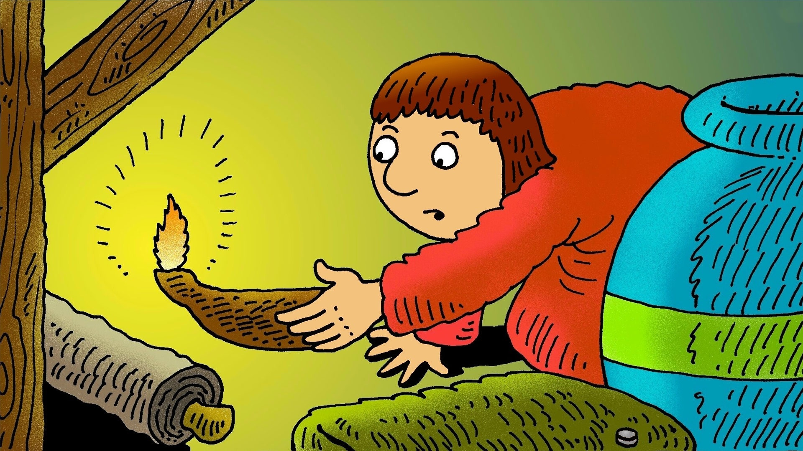
I fetched my light, searched left and right,
but no coin came in sight,
Hunted high and low, round the house I go,
it's somewhere here, I know.
I've looked in the kitchen, I've looked in the bedroom,
I've looked in every corner, round every door.

Slide 3
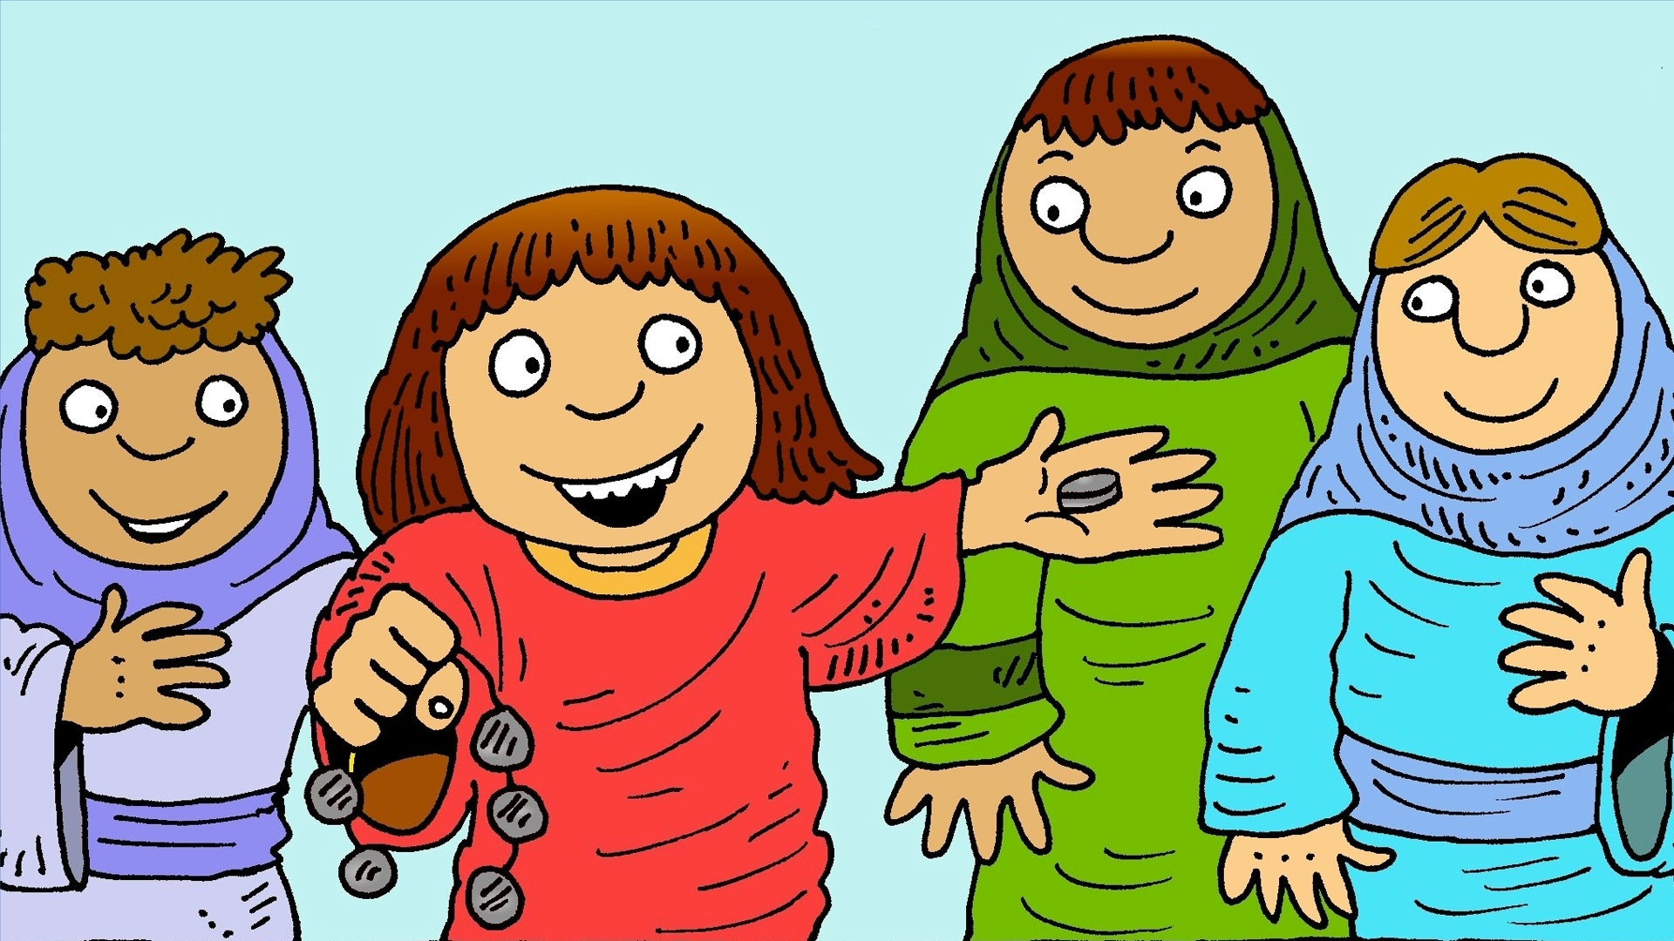
Hey, what a surprise, can’t believe my eyes,
There my coin lies.
Neighbours, come and dine, make it party time,
to celebrate my find.
Party now in each room, party with my neighbours,
Party in my own heart, party everywhere!

Slide 4
Would you believe, I'm so relieved,
'Cause what was lost has been found?
Would you believe it's the same in Heaven
when someone lost is found?
© 2020 Greg Leavers
Pictures: Richard Gunther (used with permission)

