Slide 1
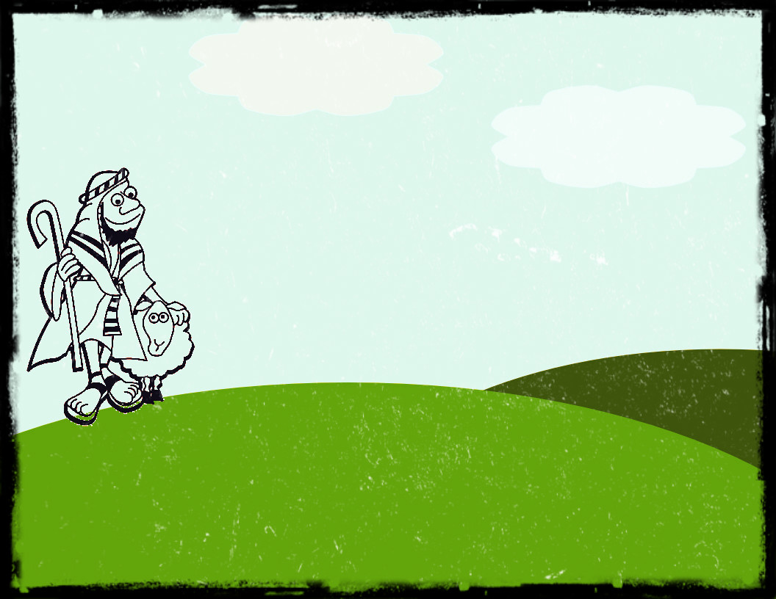
I once had a hundred sheep,
but one of them has gone.
I'm sure you've guessed that I won't rest,
until it's safe back home,
so I'll go looking high and low,
and leave the ninety-nine
in their pen ‘til I don't know when,
this lost sheep I must find.

Slide 2
Looking North, there's a horse,
looking South, there's a mouse,
looking East, some sort of beast,
looking West, I might have guessed,
Where it's steep, I see my sheep,
gives a bleat, no food to eat,
on a ledge all on its own,
I'll fetch it down and head for home!

Slide 3
What was lost has now been found,
I think it's party time,
Loads of food, it's going to be good,
to celebrate my find.
Jesus came to seek and save,
to seek and save the lost.
For each one found,
there's a joyful sound,
as heaven's party rocks!
© 2016 Greg Leavers

