Slide 1
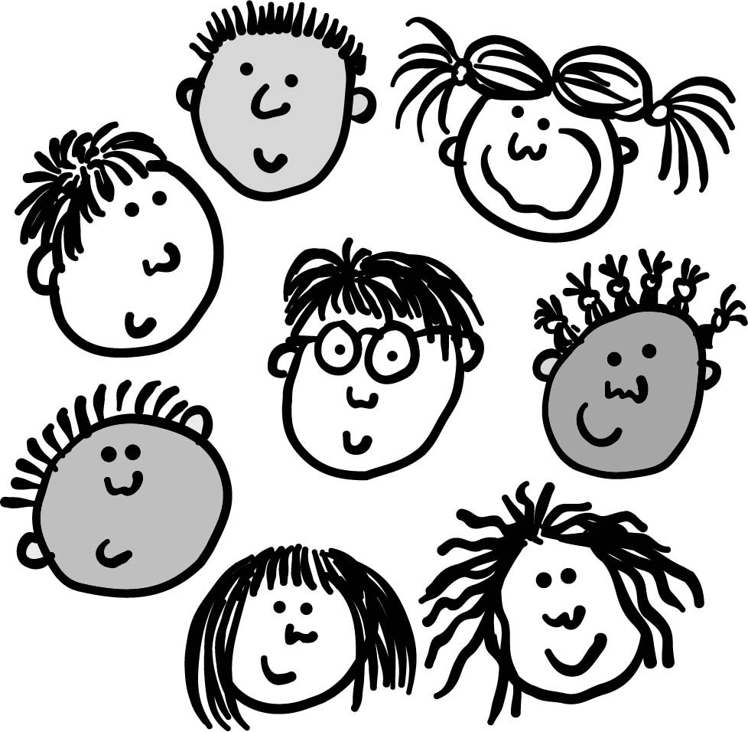
See how very much our Father loves us, (x2)
for He calls us His children, and that is what we are!
(x2)
One John chapter three verse one. (x2)
© 2010 Greg Leavers

