Slide 1
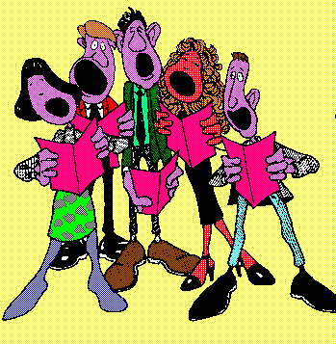
Iesu 'dyn ni'n canu dy glod
Jesus we are singing Your praise.
Iesu 'dyn ni'n canu dy glod
Jesus we are singing Your praise.
Dy gariad anhygoel
Your love’s so amazing,
Sy'n gwneud i ni ganmol
We want to keep praising,
Iesu 'dyn ni'n canu dy glod
Jesus we are singing Your praise

Slide 2
Iesu mae dy gariad di mor llydan a dwfn a mawr…
Jesus Your love’s ever so wide and deep and high…
Iesu 'dyn ni'n canu dy glod
Jesus we are singing Your praise.
Iesu 'dyn ni'n canu dy glod
Jesus we are singing Your praise.
Dy gariad anhygoel
Your love’s so amazing,
Sy'n gwneud i ni ganmol
We want to keep praising,
Iesu 'dyn ni'n canu dy glod
Jesus we are singing Your praise

Slide 3
Iesu ti'n fy 'ngharu pan dw i'n
dda neu ddrwg neu hapus neu drist…
Jesus You still love me if I’m
good or bad or happy or sad…
Iesu 'dyn ni'n canu dy glod
Jesus we are singing Your praise.
Iesu 'dyn ni'n canu dy glod
Jesus we are singing Your praise.
Dy gariad anhygoel
Your love’s so amazing,
Sy'n gwneud i ni ganmol
We want to keep praising,
Iesu 'dyn ni'n canu dy glod
Jesus we are singing Your praise

Slide 4
Iesu mae dy gariad di i bobl fel ti,
Jesus Your love reaches out to people like him,
Pobl fel hi a phobl fel _____yn flewog i gyd…
And people like her and people like ___all covered in hair…
Iesu 'dyn ni'n canu dy glod
Jesus we are singing Your praise.
Iesu 'dyn ni'n canu dy glod
Jesus we are singing Your praise.
Dy gariad anhygoel
Your love’s so amazing,
Sy'n gwneud i ni ganmol
We want to keep praising,
Iesu 'dyn ni'n canu dy glod
Jesus we are singing Your praise
© 2001 Greg Leavers
Cyf Cass Meurig Thomas

