Slide 1
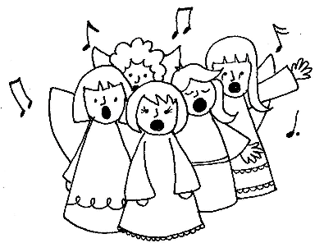
Holy, holy, glory, glory,
like the angels spread the story.
Holy, holy, glory, glory,
like the angels spread the story.
1. When the Saviour came,
Jesus His name, we now proclaim
that love came down at Jesus' birth
God's special gift from heaven to earth

Slide 2
Holy, holy, glory, glory,
like the angels spread the story.
Holy, holy, glory, glory,
like the angels spread the story.
2. Born the King of kings,
Emmanuel, God's peace He brings,
Shepherds and kings brought offerings,
And just like them, let's worship Him.

Slide 3
Holy, holy, glory, glory,
like the angels spread the story.
Holy, holy, glory, glory,
like the angels spread the story.
Copyright © 2002 Greg Leavers

