Slide 1
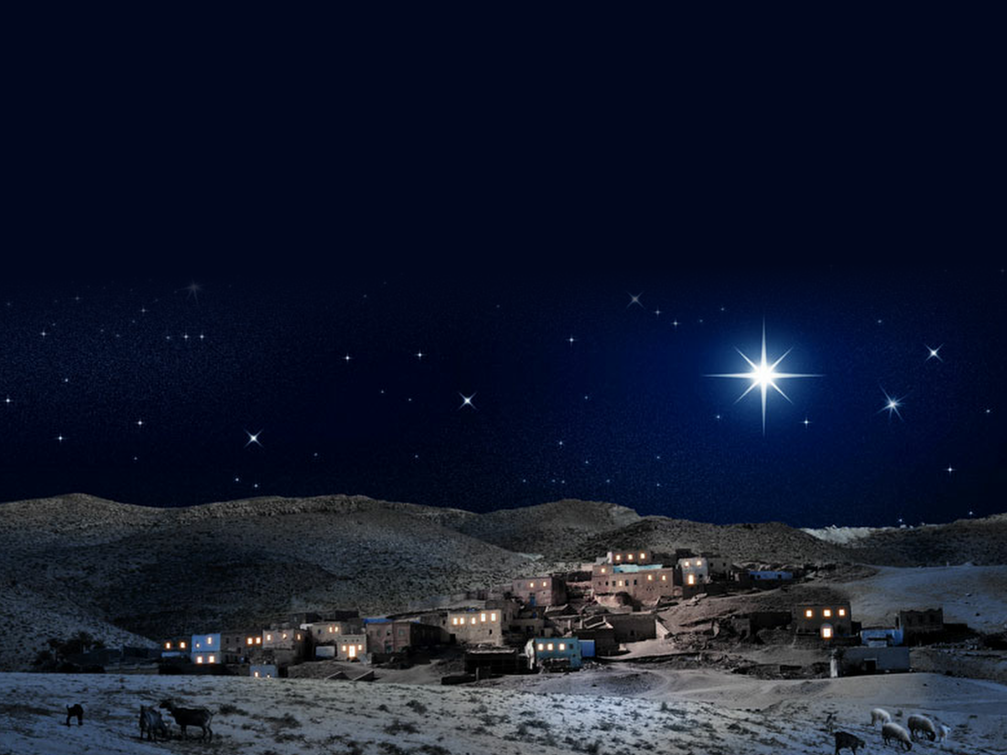
Mair a Joseff aeth - ar siwrnai pellter maith –
Mary and Joe were told they had to go
i Fethlehem (Bethlehem)
down to Bethlehem (Bethlehem)
Gorfod mynd i stabal - llety yr anifail –
They slept in a stable ‘cos innkeepers told them
i gael to uwch ben (to uwch ben)
that there was no room (was no room)
Yno yn y gwair - fe anwyd baban Mair –
Soon a baby boy, their little pride and joy
ein Iesu gwyn (Iesu gwyn)
was born to them (born to them)
Dyna meddai’r angel ac fe ddaeth yn wir.
and everything happened as the angel said.

Slide 2
Iesu, mab annwyl Duw
Jesus, Heavens delight.
Haleliwia, yn y crud. Mae’r un i ddangos i’r holl fyd
Glory! Hallelujah! Angels told us who You are.
Y ffordd fendithiol i fyw.
What a glorious night.
Iesu, mab annwyl Duw
Jesus - heavens delight.
Roddwyd i ni’n anrheg ddrud, G-W-A-Redwr y byd
Glory! Hallelujah! Our S - A - V - I - O - U - R,
Heddiw yma yn fyw.
What a glorious night.

Slide 3
Cwmni o fugeiliaid - gyda’u praidd o ddefaid –
Shepherds really scared, when at night they heard
ar y bryn (ar y bryn)
a choir of angels sing, (angels sing)
Glywodd côr angylion - yn rhannu eu newyddion –
‘Go down into town you’ll find, when you look round,
a’u gwylio’n syn (gwylio’n syn)
the promised new born King; (new born King)
Yna’n mynd gan foli - i Fethlem i addoli –
through His humble birth, bringing peace on earth.
Meseia dyn (Meseia dyn)
Go and worship Him’, (worship Him)
Dyna gân yr angel ac fe ddaeth yn wir
and everything happened as the angels said
.

Slide 4
Iesu, mab annwyl Duw
Jesus, Heavens delight.
Haleliwia, yn y crud. Mae’r un i ddangos i’r holl fyd
Glory! Hallelujah! Angels told us who You are.
Y ffordd fendithiol i fyw.
What a glorious night.
Iesu, mab annwyl Duw
Jesus - heavens delight.
Roddwyd i ni’n anrheg ddrud, G-W-A-Redwr y byd
Glory! Hallelujah! Our S - A - V - I - O - U - R,
Heddiw yma yn fyw.
What a glorious night.

Slide 5
Yna daeth y doethion - gydag eu hanrhegion –
Travelling through the night some wise men kept in sight
at y crud (at y crud)
a bright new star, (bright new star)
Dod ar siwrnau hir - ag aur a thus a myrr –
they read that it would bring them to a new born King,
yn roddion drud (rhoddion drud)
so they journeyed far, (journeyed far)
Golau seren wen - yn arwain uwch eu pen –
For gifts of great expense they brought Him frankincense,
at frenin byd (brenin byd)
with gold and myrrh, (gold and myrrh)
Dyna meddai’r ‘sgrythur ac fe ddaeth yn wir
and everything happened as the scriptures said.

Slide 6
Iesu, mab annwyl Duw
Jesus, Heavens delight.
Haleliwia, yn y crud. Mae’r un i ddangos i’r holl fyd
Glory! Hallelujah! Angels told us who You are.
Y ffordd fendithiol i fyw.
What a glorious night.
Iesu, mab annwyl Duw
Jesus - heavens delight.
Roddwyd i ni’n anrheg ddrud, G-W-A-Redwr y byd
Glory! Hallelujah! Our S - A - V - I - O - U - R,
Heddiw yma yn fyw.
What a glorious night.

Slide 7
Fe ddaeth Duw ei hun - i fyw yma fel dyn –
God sent His Son ‘cos He loves everyone,
a’n harwain ni (arwain ni)
people’s need was great, (need was great)
Mae’n hangen ni yn fawr - ac felly daeth i lawr –
Though He knew the cost He saw that we were lost
i’n hachub ni (achub ni)
so didn’t hesitate, (hesitate)
Dewch i gyd i ddathlu - diwrnod mawr ei eni –
Jesus is the reason for this Christmas season
ein Dolig ni (Dolig ni)
we can celebrate (celebrate)
Dyma wnaeth O’i addo ac fe ddaeth yn wir
for everything happened as He’d always said.
#

Slide 8
Iesu, mab annwyl Duw
Jesus, Heavens delight.
Haleliwia, yn y crud. Mae’r un i ddangos i’r holl fyd
Glory! Hallelujah! Angels told us who You are.
Y ffordd fendithiol i fyw.
What a glorious night.
Iesu, mab annwyl Duw
Jesus - heavens delight.
Roddwyd i ni’n anrheg ddrud, G-W-A-Redwr y byd
Glory! Hallelujah! Our S - A - V - I - O - U - R,
Heddiw yma yn fyw.
What a glorious night.
© Hawlfraint 2016 Greg Leavers cyf Dafydd Chilton

